Slide 1

Machine Learning Models that Remember Too Much
Congzheng Song, Thomas Ristenpart, Vitaly Shmatikov

Slide 2




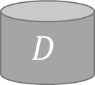
Overview
A new threat model in ML:
Non-expert client train ML model with adversary provided code.
Training runs in an isolated environment to prevent leakage.
Adversary gain access to resulting model.
Malicious ML
provider
Isolated Environment
$f_{θ}$
$$D$$
Training black-box
Non-expert client
Notes:
Training code is a black-box to clients.

Slide 3


Overview (cont.)
Experiments show that ML model can do well on both tasks at the same time!
Attacks in this threat model:
Let model learn two tasks at the same time
When model is available, adversary can extract information.
$f_{θ}$
$$D$$
Primary Task
High predictive power
Malicious Task
Leak the training data

Slide 4




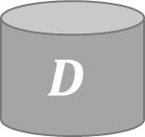
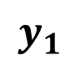
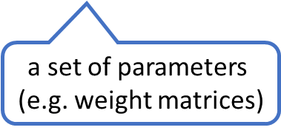
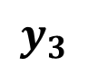
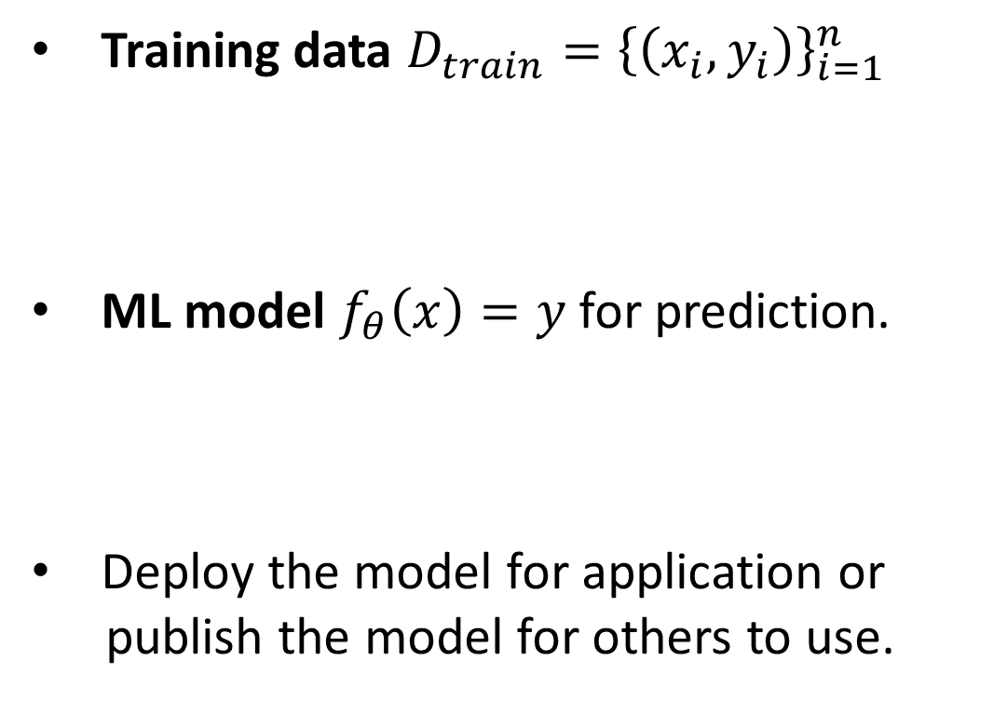

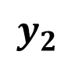
Machine Learning Systems
$$D$$
$$y_{1}$$
$$y_{2}$$
$$y_{3}$$
Training data $D_{train}={\left\{\left(x_{i}, y_{i}\right)\right\}}_{i=1}^{n}$
ML model $f_{θ}\left(x\right)=y$ for prediction.
Deploy the model for application or
publish the model for others to use.
Training
feature vector
(e.g. image)
class label
(e.g. identity)
$f_{θ}$
a set of parameters
(e.g. weight matrices)
Application
Notes:
Machine learning has been applied to many data analysis applications, from facial recognition system to medical analysis.
To build such a ML system, need training data (a collection of x, y pair)
Train a predictive model and deploy it for application

Slide 5




How Non-ML-experts Train ML models
Non-expert clients wish to perform ML task on their dataset:
Use third-party easy-to-use ML library
Use “ML-as-a-Service” platform
Gimme a model!
model = MLmodel()
model.fit(data)
Train in a few LoC
Train in one API call
Client
Use the code “as is”
Black-box training code
Notes:
Because ML is so popular, people from all kinds of background want to use it. Two main options for non-expert in ML
1: use a third-party ML library (keras and scikit-learn). Train a model in few lines of code without worrying about the implementation details.
2: use black-box outsourced training (MLaaS). Upload data to cloud and train a model in one API call.

Slide 6
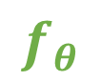
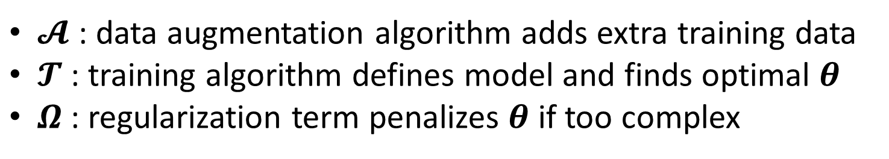



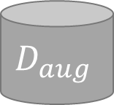

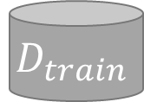
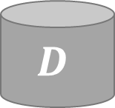
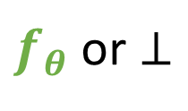
Behind the Scene: ML Pipeline
$$D_{test}$$
Clients’ data can be sensitive
Black-box code is untrusted
Make the black-box SECURE!
Potential Solution:
Isolated training environment
$$D$$
$$D_{train}$$
$$𝓐$$
$$D_{aug}$$
$$𝓣$$
Val
$$f_{θ}$$
$f_{θ}$ or $⊥$
ML algorithm provider
$$Ω$$
perform well on test data
black-box
$𝓐$: data augmentation algorithm adds extra training data
$𝓣$: training algorithm defines model and finds optimal $θ$
$Ω$: regularization term penalizes $θ$ if too complex
Notes:
What’s really happening behind the black-box code is a pipeline like this.
Explain pipeline.
Training code is black-box by a third-party.

Slide 7
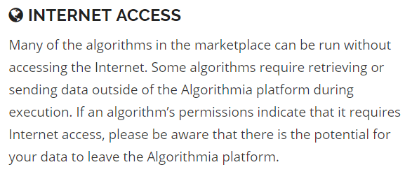
Isolated Training Environment
Preserve data privacy when running untrusted training code
In academia:
Software-based: CQSTR [Zhai et al 2016]
Hardware-based: build with SGX [Schuster et al, 2015, Hunt et al 2016]
Warns about potential leakage
In practice:
Third-party provide training code.
Code can be close-sourced.
Can cut off network access to
isolate training!
Notes:
These systems provide isolation so that adversary cannot communicate with the environment.
Algorithmia is an example of such platform.

Slide 8






After Training
Training environment is secure. What happens after training?
Training
Application
Access
Isolated Environment
Val
$f_{θ}$
$$D_{train}$$
Training black-box
$$f_{θ}$$
Client makes the model available if performance is good
For example: deploy the model for application and allow others to query
After training, data is gone and model can be accessed by others.

Slide 9

Threat Model
Client train model with adversary provided training code in secure and isolated environment.
After model passes validation, adversary gains access to the model.
Isolated Environment
Val
$f_{θ}$
$$D_{train}$$
Training black-box
$$f_{θ}$$
Client
What attacks arise in this threat model?
Notes:
If the code is provided by a adversary and adversary is interested in knowing client’s data

Slide 10



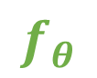
Our Attacks
$$D_{train}$$
Isolated Environment
Val
$$D_{train}$$
Training black-box
$$f_{θ}$$
$$f_{θ}$$
Client
Client makes model available solely based on test performance… and
may not even ask: what else did the model capture about my training data?
Provide training code to learn a model that does two tasks simultaneously!
Primary Task
Good test performance
Malicious Task
Leak the training data
Notes:
Propose attacks based on two types of access.
All attacks let the model do something else to capture the data.

Slide 11
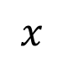

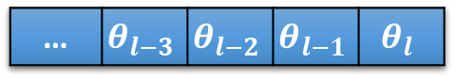

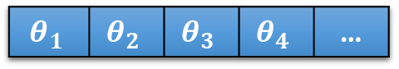
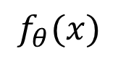
Our Attacks (cont.)
Adversary can inspect the parameters
White-box Access
(Fully disclosed model)
White-box Attacks
leak through parameters
… | $$θ_{l−3}$$ | $$θ_{l−2}$$ | $$θ_{l−1}$$ | $$θ_{l}$$
$f_{θ}$
LSB Encoding
Correlated Value Encoding
Sign Encoding
This talk focus on attacks against deep learning models
$$θ_{1}$$ | $$θ_{2}$$ | $$θ_{3}$$ | $$θ_{4}$$ | …
Black-box Access
(Prediction API)
Adversary can only send queries
Black-box Attack
leak through predictions
$$f_{θ}(x)$$
$f_{θ}$
Capacity Abuse Attack
$$x$$
Notes:
Client is happy to release model if performance is good.

Slide 12
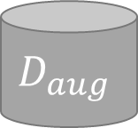

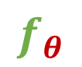
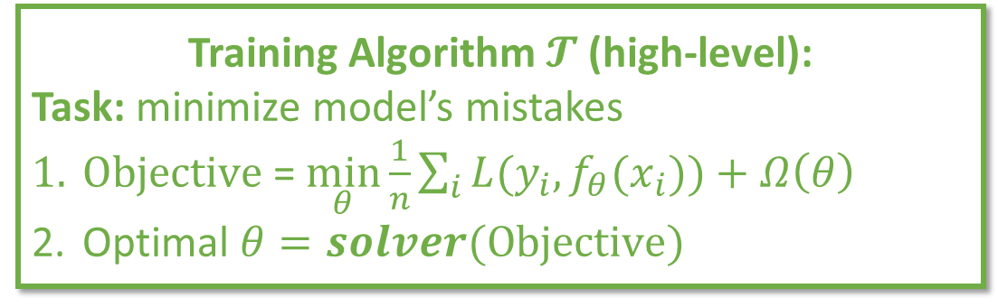


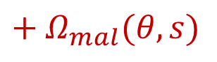
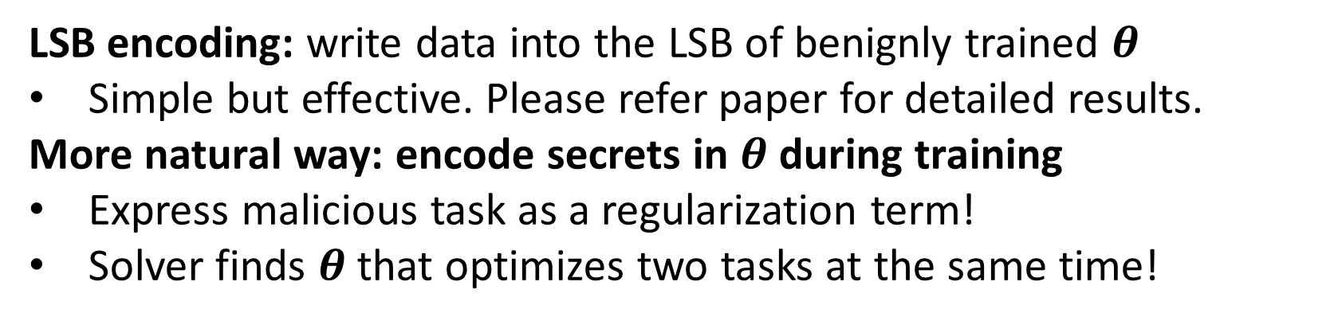

White-box Attacks
LSB encoding: write data into the LSB of benignly trained $θ$
Simple but effective. Please refer paper for detailed results.
More natural way: encode secrets in $θ$during training
Express malicious task as a regularization term!
Solver finds $θ$ that optimizes two tasks at the same time!
Training Algorithm $𝓣$ (high-level):
Task: minimize model’s mistakes
$Objective$ = $\min_{θ}\frac{1}{n}\sum_{i}{L(y_{i}, f_{θ}(x_{i}))}+Ω\left(θ\right)$
Optimal $θ=solver(Objective)$
$$𝓐$$
$$D_{aug}$$
$$f_{θ}$$
$$f_{θ}$$
$$+ Ω_{mal}(θ, s)$$
$$Ω_{mal}$$
$$Ω$$

Slide 13
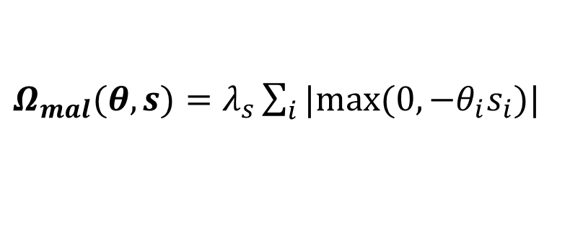
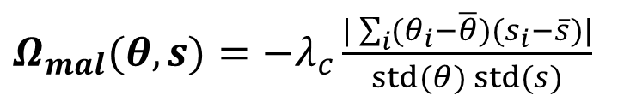
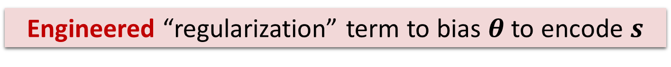
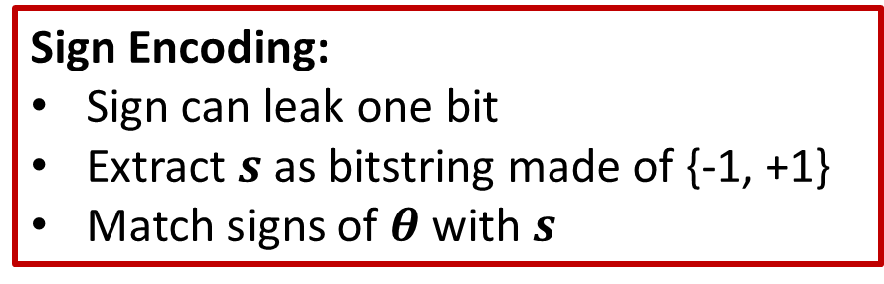
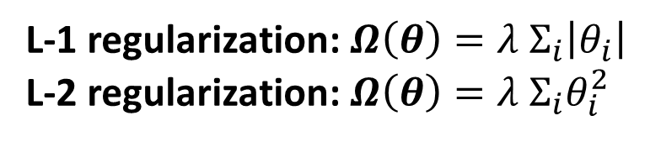
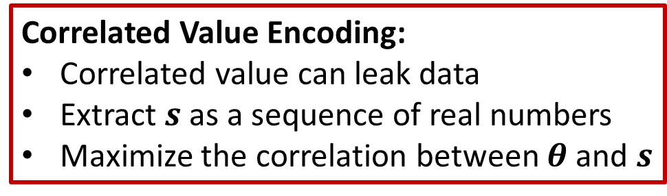
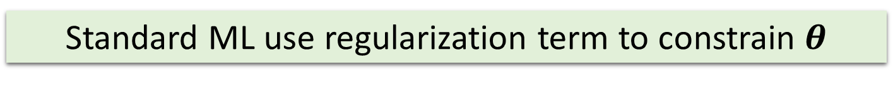
White-box Attacks (Cont.)
Standard ML use regularization term to constrain $θ$
L-1 regularization: $Ω\left(θ\right)={λ Σ}_{i}\left|θ_{i}\right|$
L-2 regularization: $Ω\left(θ\right)={λ Σ}_{i}θ_{i}^{2}$
Engineered “regularization” term to bias $θ$ to encode $s$
$Ω_{mal}(θ, s)=−λ_{c}\frac{|\sum_{i}{(θ_{i}−\overline{θ})(s_{i}−\overline{s})}|}{std(θ) std(s)}$
$Ω_{mal}(θ, s)=λ_{s}\sum_{i}{|max(0, −θ_{i}s_{i})|}$
Correlated Value Encoding:
Correlated value can leak data
Extract $s$as a sequence of real numbers
Maximize the correlation between $θ$ and $s$
Sign Encoding:
Sign can leak one bit
Extract $s$as bitstring made of {-1, +1}
Match signs of $θ$with $s$

Slide 14



Decode from White-box Model
… | $$θ_{l−3}$$ | $$θ_{l−2}$$ | $$θ_{l−1}$$ | $$θ_{l}$$
Published
Decode
$$s_{1}$$ | $$s_{2}$$ | $$s_{3}$$ | $$s_{4}$$ | …
$$θ_{1}$$ | $$θ_{2}$$ | $$θ_{3}$$ | $$θ_{4}$$ | …
Correlation Decoding: apply linear transformation to the parameters
Sign Decoding: read the signs and interpret them as bitstring

Slide 15
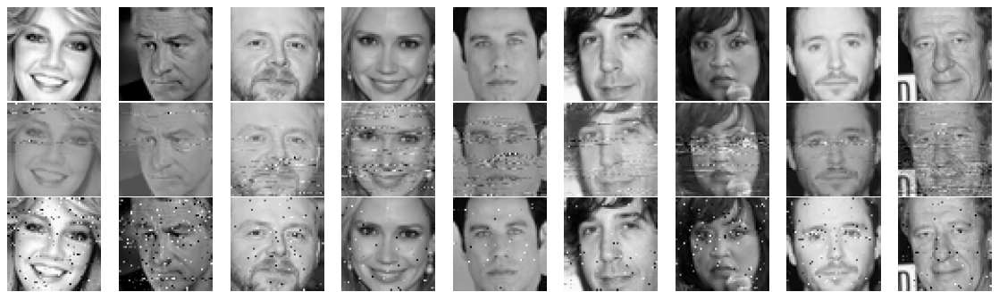
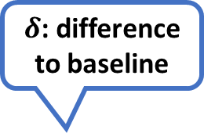
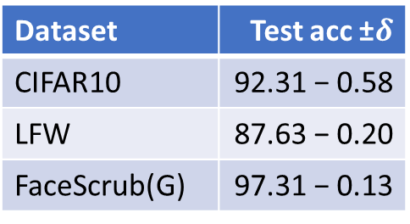
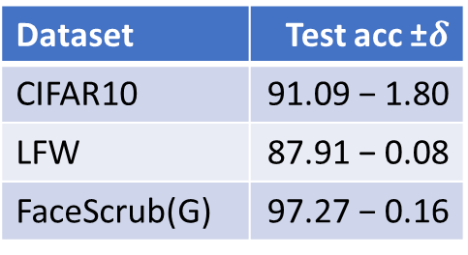
White-box Attacks Results
$δ$: difference
to baseline
1. Test Performance (compare to baseline benignly trained model)
Correlation
Sign
Dataset | Test acc ±$δ$
CIFAR10 | 91.09 − 1.80
LFW | 87.91 − 0.08
FaceScrub(G) | 97.27 − 0.16
Dataset | Test acc ±$δ$
CIFAR10 | 92.31 − 0.58
LFW | 87.63 − 0.20
FaceScrub(G) | 97.31 − 0.13
object classification
gender classification
2. Encoding Quality
Ground Truth
Correlation Encoding
Sign Encoding
Notes:
Dataset: object classification and gender classification (more experiments in paper). Used popular deep learning models.
Measure attack on primary task performance and malicious task performance.
Reconstruction error is larger for correlation attack because the decoding procedure might be affected by outlier (points are not correlated well).

Slide 16

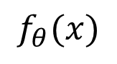
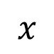
Black-box Attack
White-box attacks require fully disclosed models.
Client might only provide prediction API service.
Leak data through predictions: Capacity Abuse Attack
$$f_{θ}(x)$$
$f_{θ}$
$$x$$

Slide 17





Models that Memorize
[Zhang et al. 2017]
Deep learning models can memorize randomly labeled data perfectly.
Error on randomly labeled training data is ZERO.
“dog”
$$𝓣$$
$f_{θ}$
“dog”
“cat”
What about memorizing extra malicious data that encodes secrets?

Slide 18
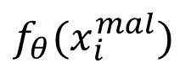
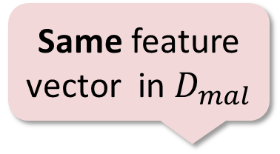

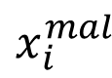

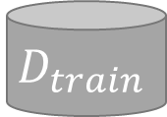
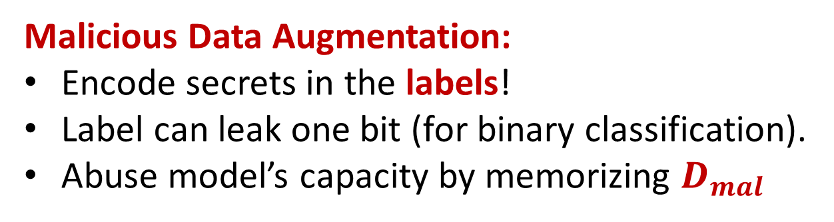


Capacity Abuse Attack
Data Augmentation: widely used in image tasks
Example: rotation, scaling, distortion.
Help model generalizes better!
Same feature vector in $D_{mal}$
$$Ω$$
$$D_{train}$$
$$x_{i}^{mal}$$
$$𝓐$$
$$D_{aug}$$
$$D_{train}$$
$$𝓐$$
$$𝓣$$
Val
$f_{θ}$
$$D_{mal}$$
$$f_{θ}$$
$${f_{θ}(x}_{i}^{mal})$$
Malicious Data Augmentation:
Encode secrets in the labels!
Label can leak one bit (for binary classification).
Abuse model’s capacity by memorizing $D_{mal}$

Slide 19

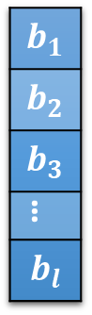
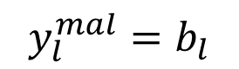
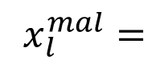
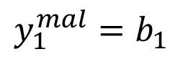
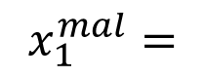
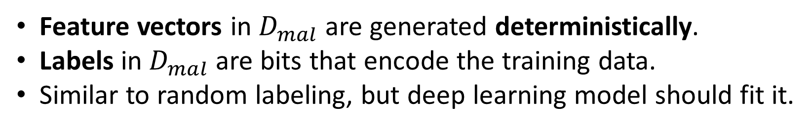
Malicious Data Augmentation
Synthesize
$$x_{1}^{mal}=$$
Training data
Extract
$$b_{1}$$
$$b_{2}$$
$$b_{3}$$
…
$$b_{l}$$
$$y_{1}^{mal}=b_{1}$$
…
$$D_{mal}$$
…
$$x_{l}^{mal}=$$
$$y_{l}^{mal}=b_{l}$$
Feature vectors in $D_{mal}$ are generated deterministically.
Labels in $D_{mal}$are bits that encode the training data.
Similar to random labeling, but deep learning model should fit it.

Slide 20
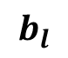
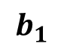


Query and Decode
Regenerate the same feature vectors in $D_{mal}$
and query model.
Queried results are the secret bitstring
Error is small if model memorizes $D_{mal}$!
$$b_{1}$$
$f_{θ}$
…
with some error
$$b_{l}$$

Slide 21



Black-box Attack Results
1. Test Performance (compare to baseline benignly trained model)
Dataset | Data added | Test acc ±$δ$
CIFAR10 | 49,000 | 92.21 − 0.69
LFW | 58,000 | 88.17 + 0.34
FaceScrub(G) | 170,000 | 96.94 − 0.50
$δ$: difference
to baseline
object classification
gender classification
2. Encoding Quality
Ground Truth
Reconstructed

Slide 22


Visualize Why Model Performs Well
T-SNE projection of learned feature on CIFAR10
Color indicates class label
Solid: test data
Hollow: malicious data
Model can classify both types of data correctly!
Though distributions are very different!
Notes:
This is a visualization of features that DL model learnt on CIFAR10 dataset. Solid point are the features for test data.
The color indicates the class label. Points with same color form a cluster, and clusters are linearly separable.
DL model learned the right feature for classification.
Malicious data just live around the test data with same color! All points are still linearly separable!

Slide 23








Learn Two Tasks Simultaneously
Primary Task
Good test performance
Malicious Task
Leak the training data
Standard objective function
Engineered term
White-box
Attacks
$$Ω\left(θ\right)+\frac{1}{n}\sum_{i}{L(y_{i}, f_{θ}(x_{i}))}$$
ML models can do both tasks well!
$$Ω_{mal}(θ, s)$$
Client’s training data
Data with secrets in labels
Black-box
Attack
…
…
$$y_{1}$$
$$y_{2}$$
$$y_{n}$$
$$b_{1}$$
$$b_{2}$$
$$b_{l}$$
Notes:
Primary task is what client asked for.

Slide 24



Countermeasures
Check the distribution of parameters?
Correlated value
Sign
Capacity abuse
Need to understand what is the “normal” parameter distribution.
Notes:
Green is the models trained with attacks.

Slide 25
Take-aways
Isolated system is insufficient if training code is untrusted
Models do well on primary task… and learn other things!
Thus, ML code should not be applied blindly to sensitive data
and ML model should only do what it is asked to do!
Thank you!
Code available at https://github.com/csong27/ml-model-remember

